Slide 1
Systems Thinking
Narratives & Metamodernism

Slide 2
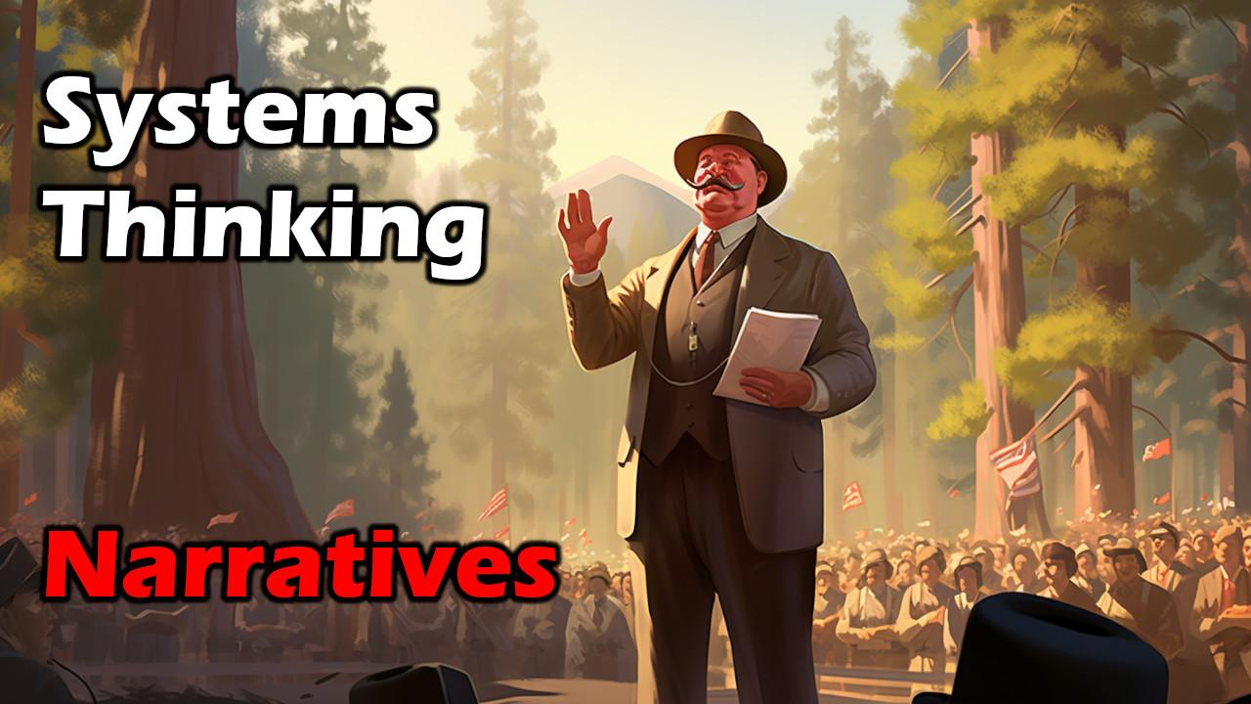

Slide 3
Narratives

Slide 4

What are narratives?
“Narratives are stories we use to make sense of the world”
Mythic and religious narratives (cosmogonic)
Cautionary tales and parables
Cultural memory and values
Social commentary and politics
Explicative narratives (science)

Slide 5

Timeline of Human Cognition
300k Years Ago - Baseline Capacity
Phenotypically modern humans emerge
We haven’t changed much physically or structurally
Therefore, maybe we already had the capacity all along
70k Years Ago - Abstract Thought
“Cognitive Revolution” happened
Lascaux cave primary example (40k years ago)
Artifacts become significantly more sophisticated
Artifacts also traveled much further than before
Art becomes more abstract (things that don’t exist, e.g. fiction)
12k Years Ago - Systemizing Behaviors
End of the Younger Dryas period (ice age)
Foundation of permanent settlements
Rise of agriculture and domestication, transition from hunters
Mythology and religion become much bigger (Gobekli Tepe)
Increasingly sophisticated social structures
Writing and more formal systems

Slide 6

Forces of Human Intellect
Curiosity: Many animals are curious. Curiosity is an impulse to gain more knowledge through exploration, trial, and experimentation.
Systematic Sensemaking: This goes beyond basic curiosity and applies system, rules, structure, and rigor to making sense of the world.
Cognitive Dissonance: This is the unpleasant sensation when we cannot reconcile two or more ideas, facts, beliefs, narratives, etc. It compels us to figure stuff out.
This is why, over time, philosophy and the human condition becomes more nuanced and sophisticated (not necessarily more complex). Science is an attempt to formalize this process. But it is entirely rooted in inborn animal instincts that evolved in humans.

Slide 7

What Are Narratives?
Definition of Narrative:
A set of stories to make sense of the world
Two overarching types of narratives
Organic Narratives
Constructed Narratives
Organic Narratives
Emerge through experience, observation, reflection, interaction, and conversation
Tend to be unstoppable and evolve naturally over time
Constructed Narratives
Deliberately propagated through messaging, often by institutions such as governments, corporations, religions, and academia
Tend to be fragile or rigid, and serve a rhetorical purpose
Subtypes of Narratives
Personal, Historical, Political, Scientific, Religious, Cultural, Economic, Social, Universal, Human

Slide 8
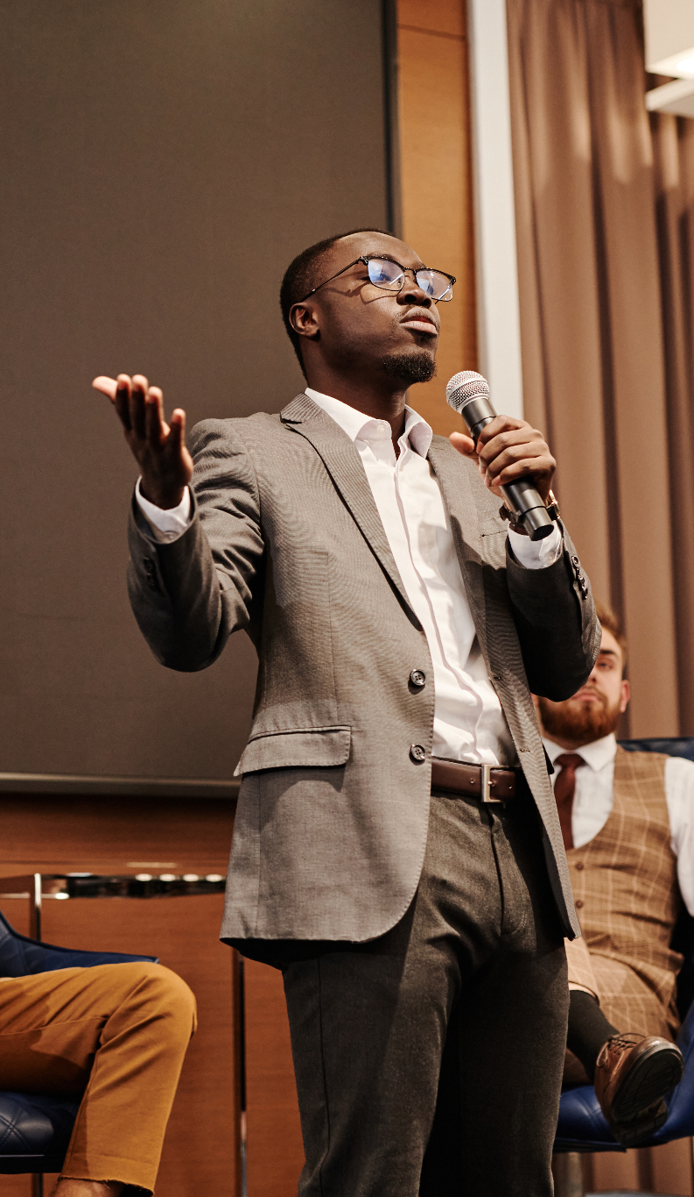
Why Are Narratives Important?
Evolution: Speech and storytelling coevolved during Cognitive Revolution
Cautionary Tales: Conveying warnings and lessons
Resource Coordination: Facilitating collaboration, e.g., hunting
Social Structure Maintenance: Gossip for community bonding, lie detection
Memory Preservation: Transmitting history and traditions
Values and Norms: Establishing shared beliefs and ethics
Understanding Complexity: Simplifying complex phenomena for comprehension; teaching and making sense

Slide 9

Truth Today
Truth today seems to be defined by four components:
A collection of evidence (facts, events, principles)
A set of interpretations or narratives
A set of generalized beliefs from the first two
A general consensus within an epistemic tribe
Remember, an epistemic tribe has norms and values around the validity of facts and expertise. When you can categorically reject most sources of information as “fake news” you can carefully cherry pick sources of “legitimate” news.

Slide 10
Metamodernism

Slide 11
Metamodernism is the inevitable result of globalism and internet. It is characterized by several things: systematic deconstruction and reconstruction of narratives; bringing narratives from implicit to explicit; rigorously alleviating cognitive dissonance; moving from an absolute or relativistic model to an emergent model; and the construction of hyper-narratives.

Slide 12
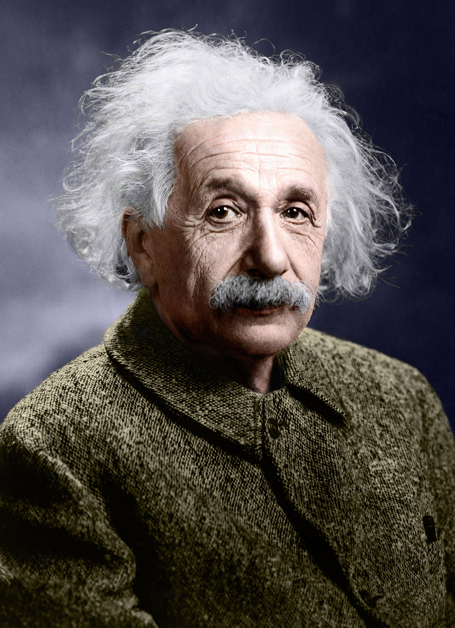
Modernism in a Nutshell
Top-Down Model
Absolute truth from on high: Truth is “out there”
Rooted in Judeo-Christian influence
Cosmic fiat or mandate
Grand Narratives: All things are objectively knowable, and external to humanity
Science
Culture and Humanity
Ethics and morality
Tend to be poetic, grandiloquent, and hyperbolic
Western colonialism and imperialism
Originated in late 19th and early 20th century
Primarily by white Europeans and American men
Still had “civilizing mission” (e.g. Westerners are the arbiters of what counts as civilization)

Slide 13

Postmodernism in a Nutshell
Relativistic Model:
Things can only be defined in relation to each other
Categorical rejection of all absolutes and narratives
“Fake news” is an example of categorical rejection
This is a lazy way of reconciling cognitive dissonance
Just a bunch of Counter-Narratives:
“No one knows anything”
“Truth or morality is relative”
“No one can define anything”
“No one can gatekeep anything”
Therefore: Throw baby out with the bathwater!
Nascent self-awareness about privilege and dominance
Characterized by insecurity, irony, sarcasm, dismissiveness, bitterness, low-effort, and cynicism
Particularly for establishment types (listen for all the bitterness from people like Jordan Peterson)
This is rooted in anger and resentment at losing power
Something of an intellectual temper tantrum by the West

Slide 14
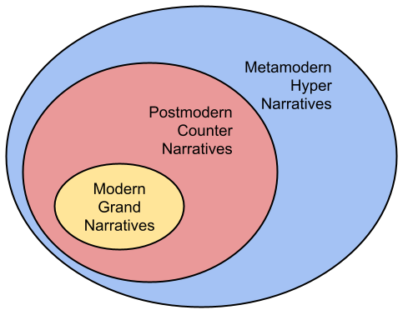
Hypernarratives
Definition of Hypernarratives: Sophisticated, layered models of reality that go beyond singular grand narratives or mere counter-narratives.
Embracing Complexity: Hypernarratives accept multifaceted truths, recognizing nuances and embracing the full spectrum of human experience.
True Metanarratives: An evolutionary step beyond modernism and postmodernism, hypernarratives represent a more mature, inclusive approach to understanding and articulating human existence.
Global Influence: The rise of globalism and the internet has fueled the development of hypernarratives, fostering greater interconnectedness and mutual understanding.

Slide 15
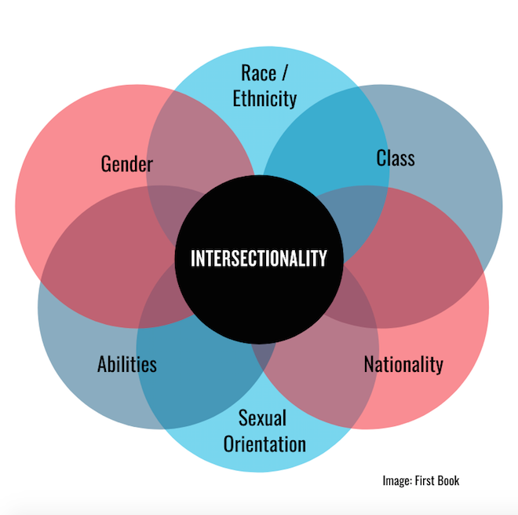
Hypernarratives Today
Intersectionality
Recognition that identities and narratives are all intrinsically composite
People belong to multiple epistemic tribes
Decolonization
Recognize historical Western dominance of science, academia, and culture
Deliberately deconstructing and reconstructing narratives with broader, global POV
Do it with dignity, rather than cynicism and hyperbole
Transdisciplinarity
Recognition of need for cross-pollination
Deconstructing silos and gatekeeping
Taking off the blinders
Beyond interdisciplinary
Synthesize entirely new disciplines to address increasingly complex problems

Slide 16
Epistemic Tribes
Epistemic Tribe: A group united by shared knowledge, beliefs, values, and cultural norms, forming a distinct worldview within a broader societal context.
Recognition of Tribes: Acceptance of numerous epistemic tribes, acknowledging diversity in thought, values, and belief systems.
Characteristics of Tribes: Unique knowledge bases, cultural norms, shared experiences, and values defining each tribe. Distinct relationship to self, others, humanity, truth, morality, etc.
Overlap & Intersectionality: Exploration of commonalities and shared spaces between tribes, fostering understanding and collaboration. We all have some underpinning ontologies in common.
Tensions Between Tribes: Acknowledgment of conflicts and disagreements, viewed through an emergence lens rather than a pathology. Can have diametrically opposed worldviews, for instance.
Beyond Echo Chambers: Shift from pathologizing to recognizing the organic emergence of tribes, emphasizing mutual respect and learning. “Echo chambers” have always existed, and serve important functions. (University)
Embracing Complexity: Emphasizing the multi-dimensional nature of tribes, promoting empathy, dialogue, and integration within a global conversation. No one tribe is the arbiter of “normal” or “truth”.

Slide 17

Metamodernism in Film
Everything, Everywhere, All at Once
Deconstructing and challenging narratives about meaning
Cuts away everything else to examine human condition in many contexts (everyone is just rocks, etc)
Weaves in trauma, abandonment, and a few social trends
Barbie
Deconstructing and challenging multiple narratives
Feminism: Promises and cognitive dissonance
Patriarchy: Male-centered culture
Toxic masculinity: Insecurity and control
Capitalism: Profit motives
Asteroid City (failed attempt)
Couldn’t quite make the jump from Postmodernism (self-aware, ironic) to Metamodernism
Nested framing narratives: “All life is but a stage” (Shakespeare)
Would have been profound… 20 years ago

Slide 18

Metamodernism in a Nutshell
Depathologizing
Pathologizing and gatekeeping are tools of control
Implied normativity intrinsically promotes one “correct” view
Nuance and Sophistication
Rather than categorical rejection to reconcile cognitive dissonance, embrace complexity
Adopt increasingly sophisticated models and frameworks
Skepticism of bitterness, appeals to power, cynicism (e.g. reject thought-stopping emotional language)
Emergence Model
Bottom-up emergence rather than top-down cosmic fiat or relativistic anything-goes view of reality
Hypernarratives
Beyond grand narratives and simple counter-narratives
Recognition of multiplicity of narratives
Aka true metanarratives
Includes ideas like intersectionality and decolonization

Slide 19
Emergence

Slide 20
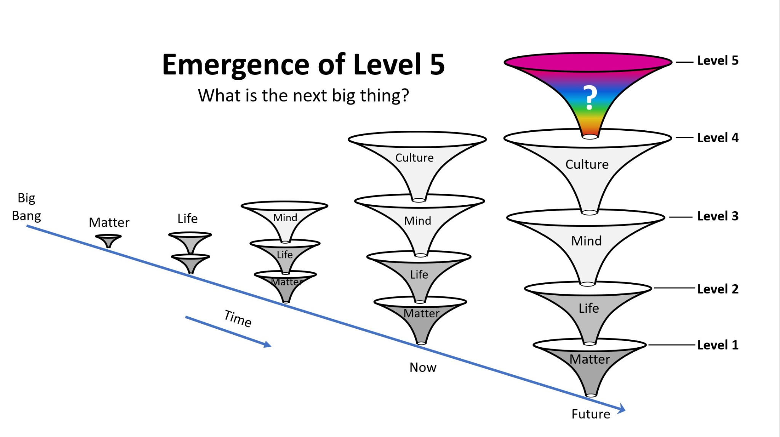
Emergence Model
Ontological Strata: Hierarchical layers of existence and complexity, each building upon and transcending the underlying layers. For instance, life emerges from underlying systems of matter and energy. Mind and intelligence emerges from underlying systems of life.
Primordial Substrate: Something underpins everything
Consciousness? Strings? Simulator? Quantum gravity? God?
Matter & Energy: Physics and chemistry
Lowest level we can directly observe and measure
Biology & Life: Systems that run contrary to entropy
Systems of matter and energy that reproduce, etc
Cognition: Individual biological systems that think & feel
Thought, memory, self-awareness, subjectivity, consciousness
Collective Constructs: Beginning of metaphysics
Society, culture, science, religion, narratives, truth, morality
Things that don’t physically exist outside our minds
But they do exist in collections of minds (like democracy)

Slide 21
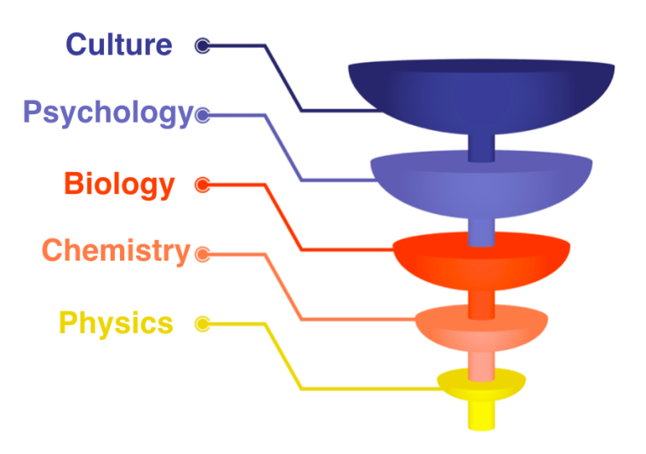
Metamodernism & Emergence
Systematic Deconstruction and Reconstruction
Pick apart, rebuild, examine (holistic, reductionist, all)
Society as components, society as gestalt, etc
From Implicit to Explicit
Articulate things clearly
Bring from unconscious to conscious
Rigorously Alleviate Cognitive Dissonance
Resolve internal tensions and double standards
Call it out when you see it, rather than categorically reject
Adopt Emergence Model
Modernism: Absolute; Top-down
Postmodernism: Relativistic; unstable, rejection
Metamodernism: Emergence; Bottom-up
Construct Hyper-Narratives
Modernism: Grand Narratives
Postmodernism: Counter-Narratives (reject everything)
Metamodernism: Hyper-narratives

Slide 22
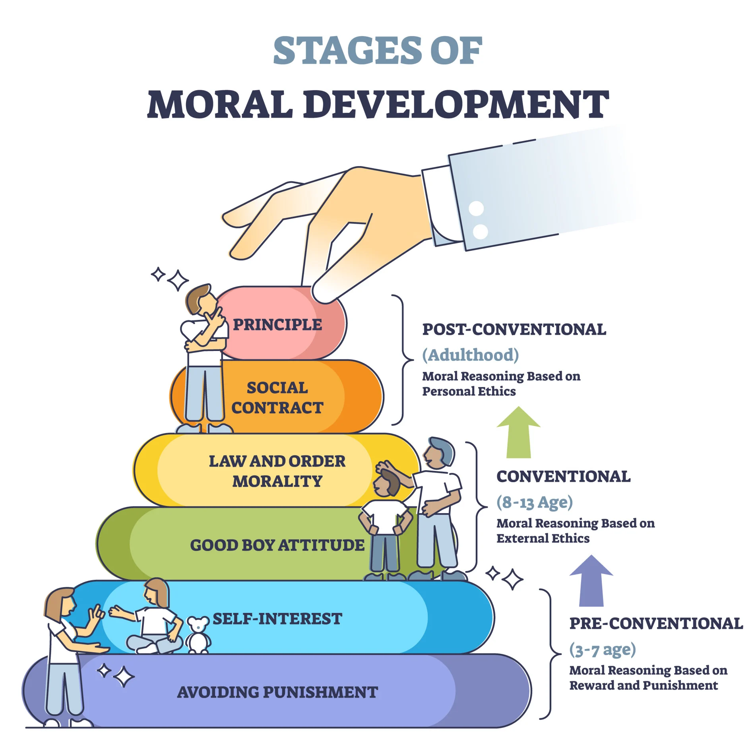
Implications of Emergence
Emergent Morality: Morality, ethics, and truth arise from bottom-up systems, not top-down decrees or relativism.
Interconnected Layers: Emphasizes adaptability and fluidity in understanding the connections between all layers.
Narrative Construction: Layer 5 constructs shaped through diverse human interactions and interpretations.
Challenges in Observation: Difficulty in observing lower strata like primordial substrate due to vast ontological distances.
Limited Experience of Lower Strata: Entities like electrons cannot experience or interact with higher-level constructs, like democracy.
Humility in Understanding: Recognition of possible unknown levels of complexity, fostering humility in our perception of existence. (Maybe souls are level 6?)

Slide 23
Current Narratives

Slide 24

Anti-Communism Narratives
“Communism is bad”
Narratives tend to become distilled/simplified over time
This makes them simple, compelling, and memorable
They also tend to over-simplify things
Origins of the narrative ultimately don’t matter
Deeply entrenched from Cold War
Served political agenda at the time
Economic Components:
Central management is evil and always fails
Free market is superior, always efficient
Redistribution inevitably leads to genocide (???)
Narrative is Evolving
Authoritarianism, dictatorships, totalitarianism, fascism is the real problem
Historical context, distillation, conversation, debate

Slide 25

Neoliberalism Narratives
Counter-narrative against “embedded liberalism”
Strong unions, labor rights
Welfare state, intervention
Managed services and goods
Class solidarity
National autonomy
Characteristics of Neoliberal Narrative:
Unions are bad
Deregulation is good
Small government is good
Taxing business and wealthy is bad
Privatization is good
Globalism is good
Society does not exist, only individuals and families
People are fundamentally self-serving
Response to events:
Oil shocks
Inflation, recessions
Labor strikes

Slide 26

“AI will kill everyone”
This is a fictional narrative
AI hasn’t killed anyone yet (on purpose)
Some people argue AI doesn’t even exist yet
Rooted entirely in novels, TV, movies, and games
AI as an extinction risk has… zero actual evidence
Who benefits?
Businesses seeking regulatory capture: “AI is dangerous so you need to regulate the heck out of it! Trust us!”
People who make a living extolling the dangers of AI: “Trust me, AI is gonna kill everyone, now give me money for a speaking engagement!”
Governments seeking excuses for more surveillance and control: “Well, you said AI is dangerous, so we gotta really crack down for the sake of freedom and safety”

Slide 27
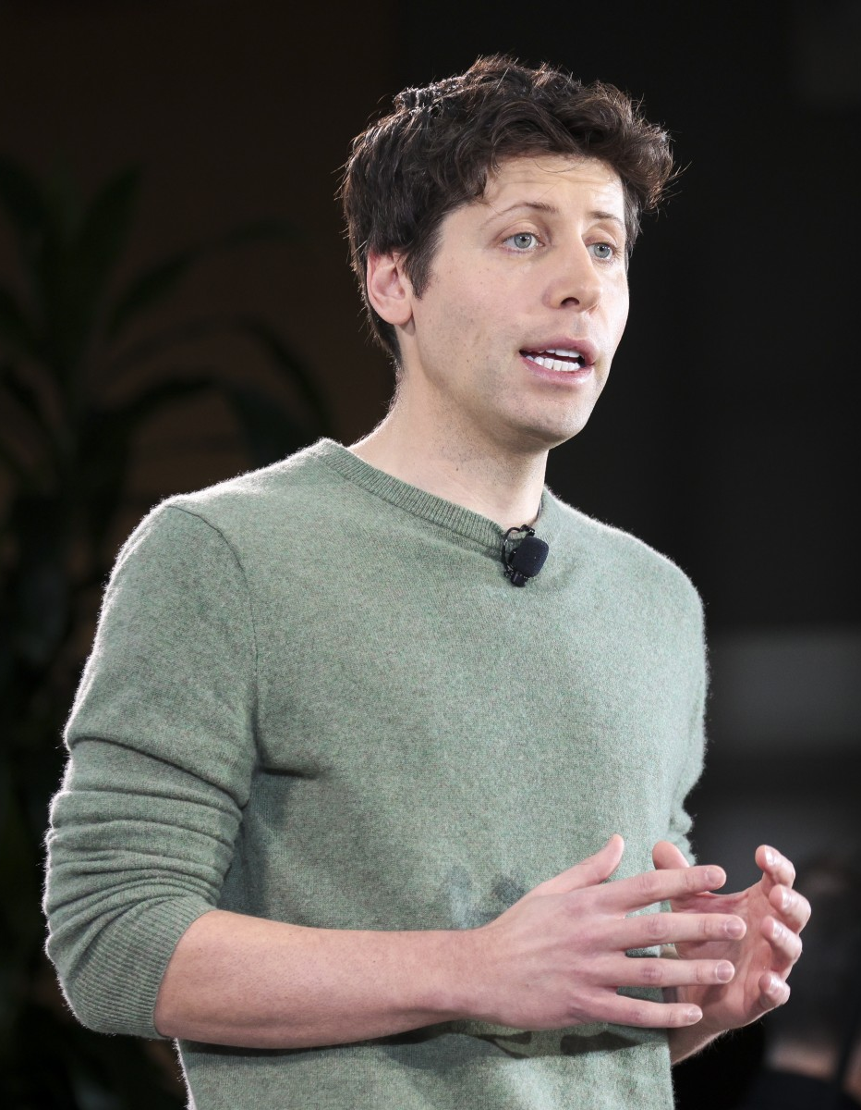
“AI will fix everything”
This is also a fictional narrative
AI has only changed a few things so far
Objectively speaking, AI has done a lot of harm (Cambridge Analytica, etc)
AI might do a lot of good, if we use it correctly
In short: we really hope that AI will do good, but this is a hope and dream, not fact.
Who benefits?
Businesses seeking deregulation and acceleration: “AI is gonna fix everything, trust us! Full speed ahead!”
People who make a living extolling the values of AI: “Here’s 4.89 million ways to make a billion dollars on ChatGPT!!!!”
Governments seeking new tools and weapons: “You mean we can automate drone strikes and surveillance?”

Slide 28

“Metacrisis” narrative
Assertion: All calamities are interrelated, connected, and caught in a vicious cycle, and it’s all about to spiral out of control!
Environmental crisis: collapse, climate change
Economic crisis: inequality, wealth concentration, market failures
Technology crisis: AI, bioweapons, nuclear
Cultural crisis: meaning crisis, patriarchy, etc
Political crisis: alt right, social media, polarization
Human nature: Greed, myopia, etc
Remember, this is just a narrative, an interpretation of evidence, accumulated into a belief system
It’s particularly potent because it’s spooky and scary
“If it bleeds it leads”
Uses mythic and demonic iconography (Moloch)
The Metacrisis is a failed attempt at hypernarrative

Slide 29
Thank you

